Slide 1
Chapter 39 File and Directory
Chien-Chung Shen
CIS/UD
cshen@udel.edu

Slide 2


OS Abstractions
Allow a program to run as if it is in its own private, isolated world (own CPU and memory)
process: virtualizing CPU
address space: virtualizing memory
Persistent storage: hard disk and solid-state drive (SSD)
Big question: how to manage persistent devices
Two goals of managing persistent data:
improving performance
improving reliability
Abstractions of storage?
file and directory

Slide 3
Abstractions of Storage
File
A named linear array of bytes you can read or write
low-level name: inode number
Directory
a file itself (and hence has an inode #)
containing a list of [user-readable name, low-level name] pairs
directory hierarchy (tree)
root directory (/) and sub-directory
absolute names begins with root directory (/)

Slide 4
The Importance of Naming
(In Unix), the first step to accessing any resource is being able to name it
In Unix, virtually everything (files, device, pipe, etc.) that you can think of is named through file system
uniformity of naming eases conceptual model of system, and makes system simpler and more modular
In Unix, file system provides a unified way to access files on disk, SSD, USB stick, CD-ROM, many other devices, and in fact many other things, all located under the single directory tree

Slide 5
File System Interface
Create, access (read/write), and delete files
Get information about files
Make, read, and delete directories

Slide 6
Create Files
Creating files via open system call
int fd = open("foo", O_CREAT | O_WRONLY | O_TRUNC,
S_IRUSR|S_IWUSR);
create (O_CREAT), if it does not exist, write-only (O_WRONLY) file in current working directory
if file already exists, remove any existing content by truncating it to zero-byte file (O_TRUNC)
permission: readable/writable by owner (USR)
return (per-process) file descriptor (an integer representing a capability [an opaque handle] that gives you power to performance certain operations)
as a pointer to an object of type struct file

Slide 7
Open Files in struct proc
file descriptors are managed by OS on a per-process basis
// offset

Slide 8
Read/Write Files
prompt> echo hello > foo
prompt> cat foo hello prompt>
Trace system calls made by a running program
strace on Unix/Linux and dtruss on Mac OS
prompt> strace cat foo ... open("foo", O_RDONLY|O_LARGEFILE) = 3 // why 3?
read(3, "hello\n", 4096) = 6 // why 6?
write(1, "hello\n", 6) = 6
hello read(3, "", 4096) = 0
close(3) = 0
... prompt>
64-bit offset
For “write,” do strace dd if=foo of=bar
(dd - convert and copy a file)

Slide 9
Non-sequential Read/Write
Sequential
Random: read/write to a specific offset within a file
Part of the abstraction of an open file is that it has a current offset, which is updated in one of two ways
when a read/write of N bytes takes place, N is added to the current offset (each read/write implicitly updates offset)
explicitly with lseek
off_t lseek(int fildes, off_t offset, int whence);
offset positions file offset to a particular location within the file
whence determines exactly how seek is performed
OS tracks a “current” offset, which determines where the next read or write will begin reading from or writing to within the file

Slide 10
// inode
// offset
system wide
(OFT)
per process

Slide 11
Open File Table
Each process maintains an array of file descriptors, each of which refers to an entry in the system-wide open file table
Each entry in open file table tracks
which underlying file the descriptor refers to
the current offset
other relevant details such as whether the file is readable or writable
(OFT)

Slide 12
File Table Entry and Offset
entries 10 and 11 of Open File Table
each current offset is updated independently
use lseek() to reposition current offset

Slide 13
Share File Table Entries
$ ./fork-seek
child: offset 10
parent: offset 10
$

Slide 14
Write Immediately
File system, for performance reasons, will buffer write()’s in memory for some time (say 5 seconds); at that later point in time, write()(s) will actually be issued to the storage device ➔ eventual guarantee
fsync(int fd) forces all dirty (i.e., not yet written) data to disk
Sometimes, need to fsync() the directory that contains the file foo
ensures not only that the file itself is on disk, but that the file, if newly created, also is durably a part of the directory

Slide 15
Rename Files
rename(char *old, char *new) is (usually) implemented as an atomic call with respect to system crashes
if the system crashes during the renaming, the file will either be named the old name or the new name, and no odd in-between state can arise
int fd = open("foo.txt.tmp", O_WRONLY|O_CREAT|O_TRUNC); write(fd, buffer, size); // write out new version of file fsync(fd); close(fd);
rename("foo.txt.tmp", "foo.txt");

Slide 16
Get Info about Files
File system keep information, termed metadata, about each file
Obtain metadata for each file via stat() or fstat()

Slide 17
Get Info about Files
[cisc361:/usa/cshen/361 1077] echo hello > foo
[cisc361:/usa/cshen/361 1078] more foo
hello
[cisc361:/usa/cshen/361 1079] stat foo
File: 'foo'
Size: 6 Blocks: 3 IO Block: 1048576 regular file
Device: 29h/41d Inode: 73985 Links: 1
Access: (0664/-rw-rw-r--) Uid: ( 4157/ cshen) Gid: ( 4157/ cshen)
Access: 2018-12-02 23:06:59.243498589 -0400
Modify: 2018-12-02 23:08:42.979511362 -0400
Change: 2018-12-02 23:08:42.979511362 -0400
Birth: -
[cisc361:/usa/cshen/361 1080] ls -i foo
73985 foo
[cisc361:/usa/cshen/361 1081]
All info of each file is stored in the inode (persistent) structure

Slide 18
Remove Files
What system call does rm use to remove a file?
Trace system calls made by program (command) rm
On Linux
> strace rm foo
…
unlinkat(AT_FDCWD, “foo”, 0) = 0
…
unlink()/unlinkat() takes the name of the file to be removed, and returns zero upon success

Slide 19
Make/Read/Delete Directories
Directory-related system calls to make, read, delete directories
Can never write to a directory directly

Slide 20
Hard Links
Why removing a file is performed via unlink() ?
link(const char *existing, const char *new)
takes two arguments, an old pathname and a new one; when you “link” a new file name to an old one, you essentially create another name to refer to the same file in the directory
prompt> echo hello > file
prompt> cat file hello prompt> ln file file2 // link old new
prompt> cat file2
hello
prompt> ls -ial file file2
61696 -rw-r--r-- 2 cshen cshen 6 2016-05-13 09:52 file
61696 -rw-r--r-- 2 cshen cshen 6 2016-05-13 09:52 file2
but refer it to the same inode number

Slide 21
Hard Link
Creating a file really does two things
making a inode that will track virtually all relevant information about the file, including its size, where its blocks are on disk, etc.
linking a human-readable name to that file, and putting that link into a directory
After creating a hard link to a file, to the file system, there is no difference between the original file name (file) and the newly created file name (file2); indeed, they are both just links to the underlying metadata about the file, which is found in inode number 61696

Slide 22
Hard Link
When file system unlinks file, it checks a reference count within the associated inode
This reference (link) count allows file system to track how many different file names have been linked to this particular inode
When unlink() is called, it removes the “link” between the human-readable name (the file that is being deleted) to the given inode and decrements the reference count
only when the reference count reaches zero does the file system also free the inode and related data blocks, and thus truly “delete” the file

Slide 23
Symbolic (Soft) Links
Hard links have limitations
can’t create one to a directory (for fear that you will create a cycle in the directory tree)
can’t hard link to files in other disk partitions (because inode numbers are only unique within a particular file system, not across file systems)

Slide 24
Symbolic (Soft) Links
A symbolic link is actually a file itself, of a different type, containing the pathname of the linked-to file
d: directory
-: regular file
l: symbolic link
Possible of dangling reference

Slide 25
File Sharing via Links
Attributes of a Unix file are stored in its inode on disk
Unix command: ls –i (show inode #)
When a file is opened, its inode is copied into memory for speedy access
With the use of inode, a file may be accessed from different directories via different names
A link is a way to establish a connection between a file (to be shared) and the directory entries of the users who want to have access to the file
a file has N (hard) links == a file has N directory entries
facilitate file sharing by providing different access paths (or file names) to a shared file
The level of sharing is controlled by access permission
you may create links to files to which you do not have any access (permission)

Slide 26
Types of Links
Hard links
ln [options] existing-file new-file
// create a hard link to ‘existing-file’ and name it
// ‘new-file’ (the file itself is not copied)
// try ln b b.hard and ls –il
ln [options] existing-file-list directory
Soft (symbolic) links
ln –s[options] existing-file new-file
ln –s[options] existing-file-list directory

Slide 27
Hard Links
Hard link: pointer to the inode of a file
When a file is created, Unix allocates a unique inode to the file, and create a directory entry [inode #, file name] in the directory in which the file is created
inode # is used to index inode table
Link count == # of directory entries
when link count becomes 0, release inode for recycling and deallocate disk blocks

Slide 28
two names for the same file
$ ln Chapter3 Chapter3.hard
$ ls –il
(show attributes of files)

Slide 29
Hard Links
When create a file, two things are done
make a inode that will track all relevant information about the file
link a human-readable name to that file, and putting that link into a directory
When file system unlinks file, it checks link count
Only when link count reaches 0 does file system free the inode and related data blocks, and thus truly “delete” the file

Slide 30
$ ln ~/memos/memo6 memo6.hard

Slide 31
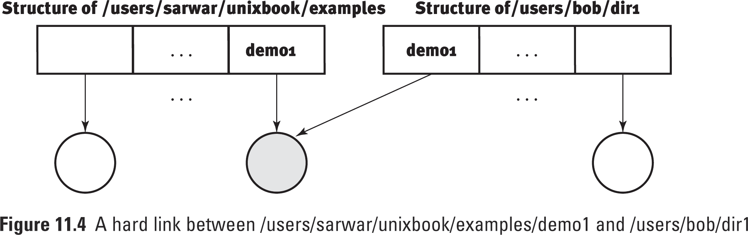
Issues with Hard Links
Issues with (limitation of) Hard Links
no hard links to a directory (why ?)
no hard links across file systems (why ?)
Notes:
It may create loops

Slide 32
Soft/Symbolic Links
$ ln –s Chapter3 Chapter3.soft
Soft link is a file itself containing “pathname” for the file that the link file is a symbolic link to
3 files types
regular file (-)
directory (d)
symbolic link (l)

Slide 33
Pros & Cons of Symbolic Links
Pros
can be establishes between files across file systems and to directories
files that symbolic links point to can be edited by any kind of editor without any ill effects
Cons
if the file that the symbolic link points to is moved from one directory to another, it can no longer be accessed via the link
Unix has to support an additional file type (the link type) and a new file has to be created for every link
slow file operations because for every reference to the file, the link file has to be opened and read in order to reach the actual file

Slide 34
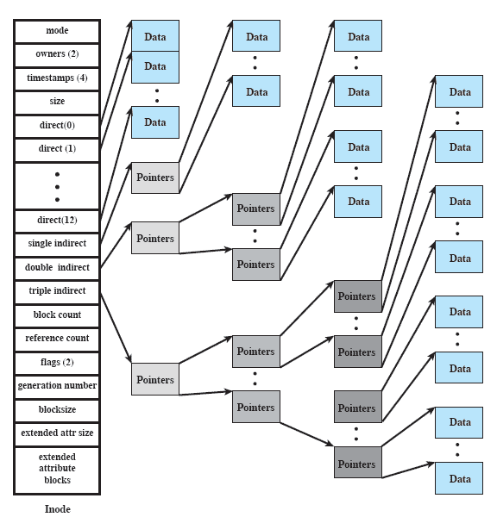
Unix File and inode
Several file (path) names may be associated with a single inode
an active inode is associated with exactly one file
each file is controlled by exactly one inode

Slide 35
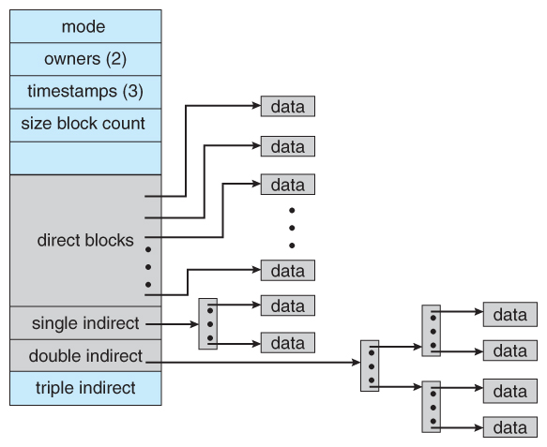

Slide 36
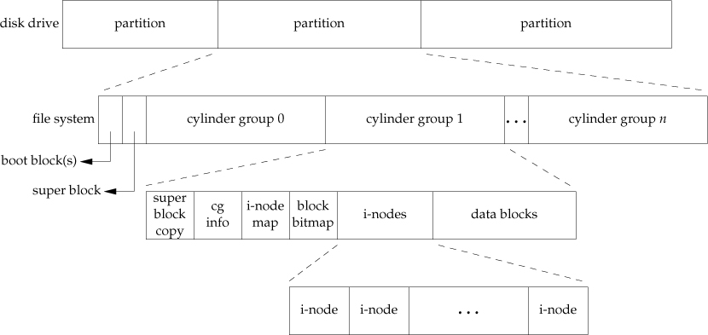
Disk Drive, Partitions, File System
Figure 4.13 Disk drive, partitions, and a file system

Slide 37
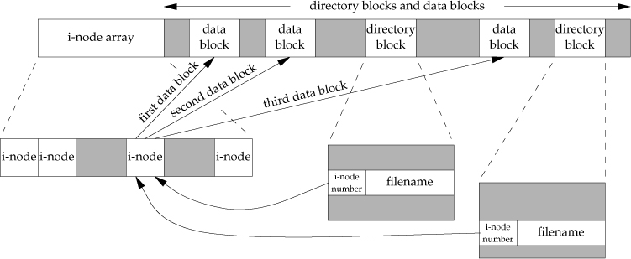
i-Node and Data Blocks
i-node contains all the information about a file: its file type, file’s access permission bits, the size of the file, pointers to the file’s data blocks, etc.
Every i-node has a link count that contains the number of directory entries that point to it
Only when the link count goes to 0 can the file be deleted
Only two items of interest are stored in the directory entry: filename and i-node number
Figure 4.14 Cylinder group’s i-nodes and data blocks

Slide 38
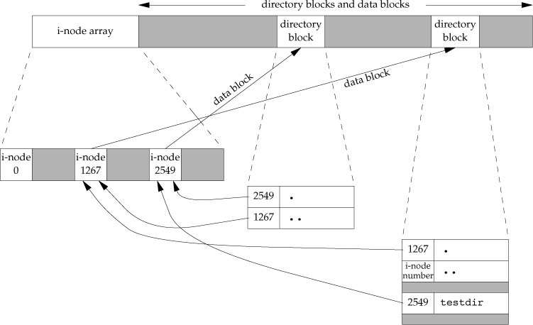
After Creating Directory testdir
Figure 4.15
The i-node whose number is 2549 has a type field of directory and a link count equal to 2
Any leaf directory (a directory that does not contain any other directories) always has a link count of 2
The value of 2 comes from the directory entry that names the directory (testdir) and from the entry for dot in that directory
Every subdirectory in a parent directory causes the parent directory’s link count to be increased by 1

